Slide 1
A Universe of Proportions: Scaling and Ratios in Physics and Beyond
Cole Prather
November 1, 2023

Slide 2
Outline
Introduction
Analogies
Ratios and Proportions
Projections
Relations and Equations
Examples and Insights
Conclusion

Slide 3
Introduction
Observations
Ratios and Comparisons of Change
Analogies and Inference
Cognition and Compartmentalization
Natural Philosophy
Physics

Slide 4
Analogies
Comparison between two forms that may share a property
At the core of cognition
Logical inference rather than abduction, induction, or deduction
The word “analogy” comes from the Latin “analogia” and originates from the Greek word for proportion, ἀναλογία
Logic: A is to B as C is to D
A:B = C:D or A:B::C:D

Slide 5
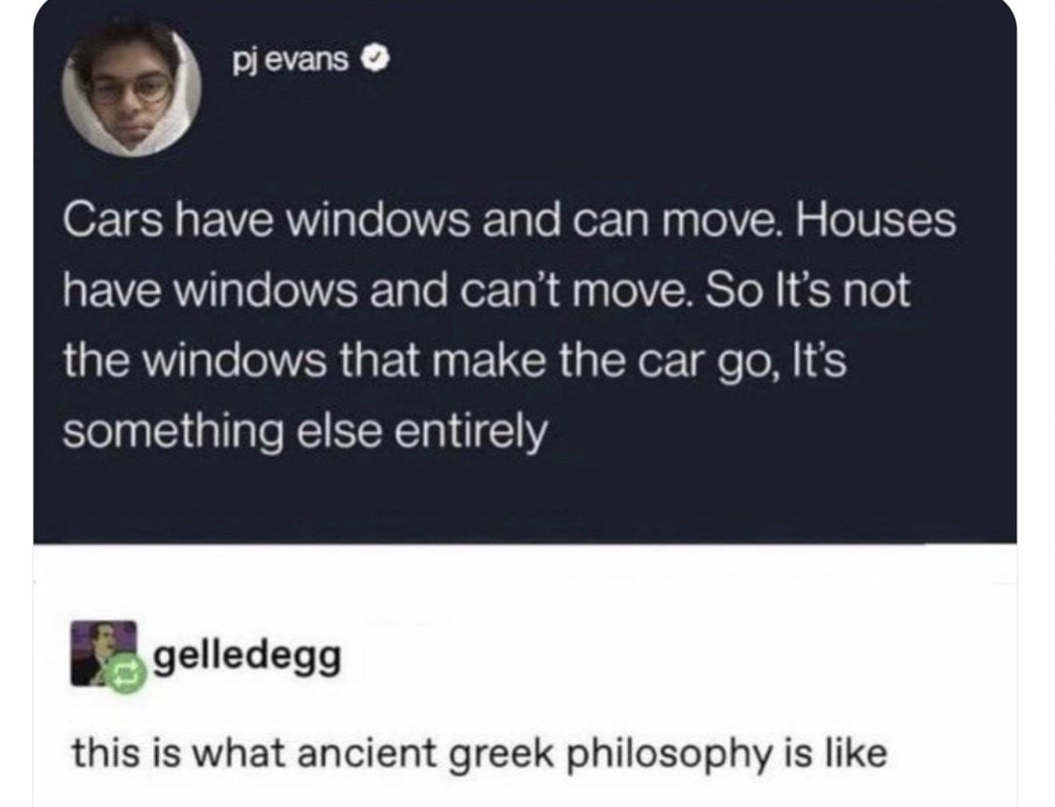

Slide 6
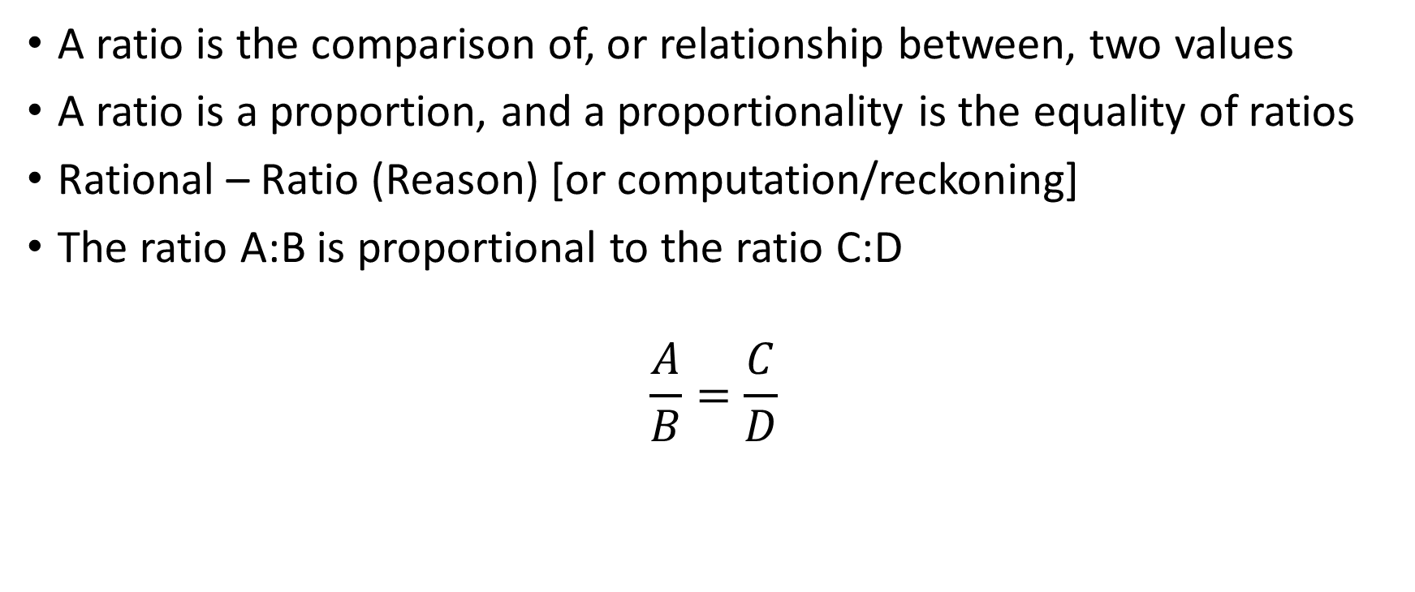
Ratio and Proportions
A ratio is the comparison of, or relationship between, two values
A ratio is a proportion, and a proportionality is the equality of ratios
Rational – Ratio (Reason) [or computation/reckoning]
The ratio A:B is proportional to the ratio C:D
$$\frac{A}{B}=\frac{C}{D}$$

Slide 7
Geometry
Consider two similar right triangles
The lengths of their sides are different, and angles are same
The ratio of the lengths of their respective sides is proportional
Some aspect of the angle is proportional to these ratios
Sine, Cosine, Tangent
Sine is the opposite or perpendicular proportion (projection)
Cosine is the adjacent or parallel proportion (projection)
Tangent is the ratio of these proportions!

Slide 8
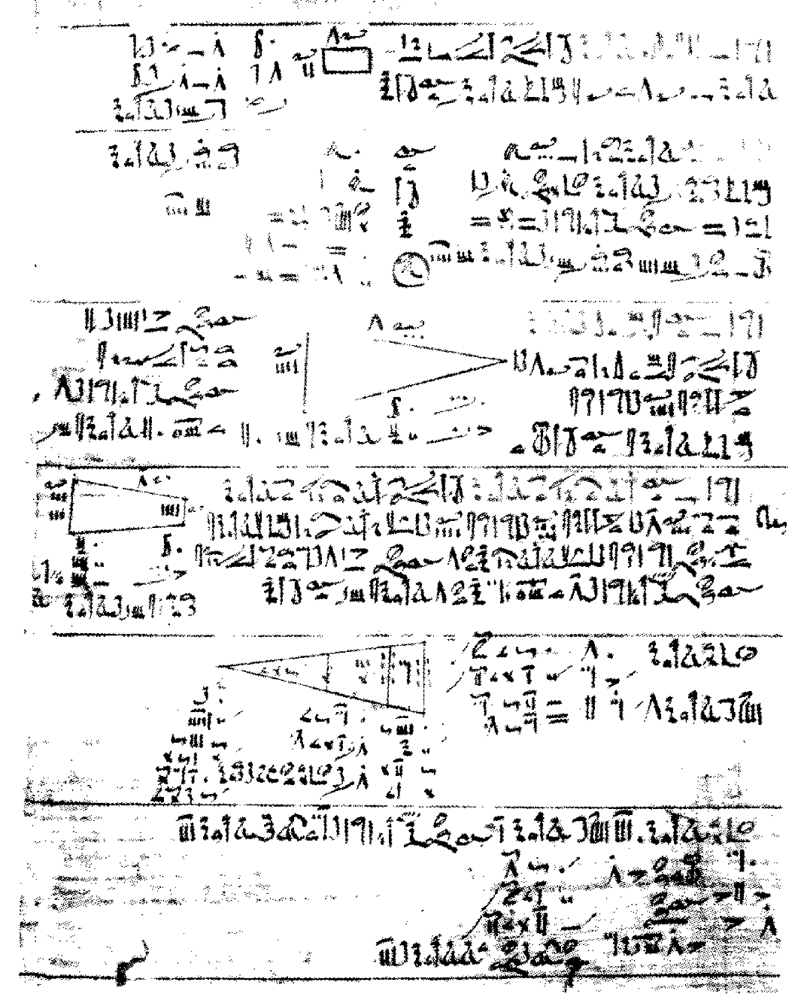

Projections
Ratios of lengths of triangle sides
Plimpton 322 – Babylon ~1800 BC
Seked – Slope
Rhind Papyrus - Egypt ~1550 BC
Estimated $π$ as 256/81
Sun projects a shadow of a figure
Sundial ~1500 BC
Theory of Proportions
Pythagoras ~500 BC (RIP Hippasus of Metapontum)
Sine, Cosine, and Tangent (Tables)
Al-Khwarizmi ~9th century

Slide 9
Relations and Equations
Proportions -> Relations -> Equations
But wait, not everything scales linearly!
Consider a bunch of little triangles/slopes.. (differentials!)
Some values scale as a ratio of ratios
The tangent function is a ratio of ratios!
Equations are essentially complex rational proportionalities
(and are approximations!)

Slide 10
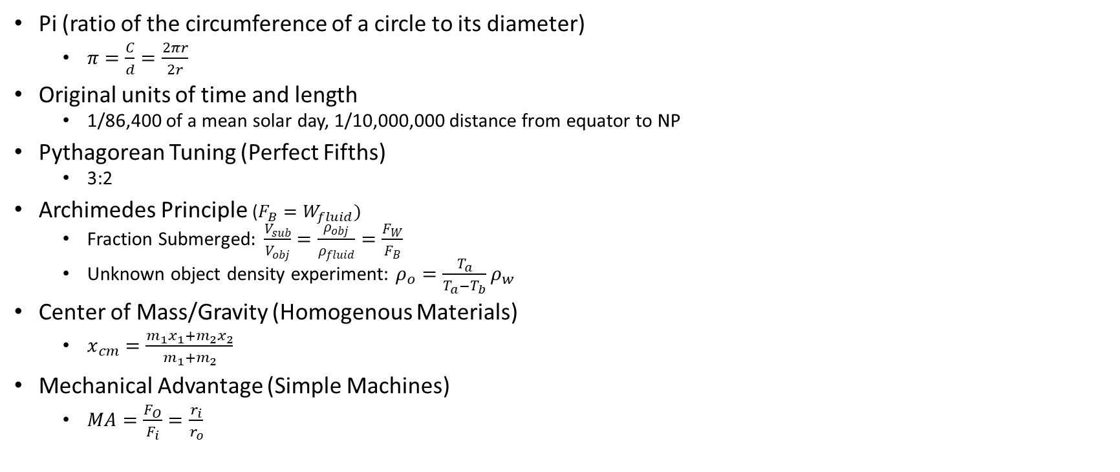
Examples of Ratios and Proportions
Pi (ratio of the circumference of a circle to its diameter)
$π=\frac{C}{d}=\frac{2πr}{2r}$
Original units of time and length
1/86,400 of a mean solar day, 1/10,000,000 distance from equator to NP
Pythagorean Tuning (Perfect Fifths)
3:2
Archimedes Principle ($F_{B}=W_{fluid})$
Fraction Submerged$: \frac{V_{sub}}{V_{obj}}=\frac{ρ_{obj}}{ρ_{fluid}}=\frac{F_{W}}{F_{B}}$
Unknown object density experiment: $ρ_{o}=\frac{T_{a}}{T_{a}−T_{b}}ρ_{w}$
Center of Mass/Gravity (Homogenous Materials)
$x_{cm}=\frac{m_{1}x_{1}+m_{2}x_{2}}{m_{1}+m_{2}}$
Mechanical Advantage (Simple Machines)
$MA=\frac{F_{O}}{F_{i}}=\frac{r_{i}}{r_{o}}$

Slide 11

Examples of Ratios and Proportions
Kepler’s Third Law (Law of Harmonies)
$\frac{T_{1}^{2}}{T_{2}^{2}}=\frac{r_{1}^{3}}{r_{2}^{3}}$
Pascal’s Principle
$\frac{F_{1}}{F_{2}}=\frac{A_{1}}{A_{2}}$
Newton’s Second Law
$F=\frac{∆p}{∆t}$
Kinetic Energy and Velocity
$\frac{KE_{i}}{KE_{f}}=\frac{v_{i}^{2}}{v_{f}^{2}} (for same mass)$
Energy and Efficiency
$ε=\frac{∆KE}{∆PE}=\frac{W_{out}}{E_{in}}$
Angular Speed and Torque (Gear Ratio)
$\frac{ω_{1}}{ω_{2}}=\frac{Τ_{2}}{Τ_{1}}=\frac{d_{2}}{d_{1}}$

Slide 12

Examples of Ratios and Proportions
Gas Laws
Relative Humidity
$\% RH=\frac{vapor density}{saturation vapor density}×100\%$
Specific Heat
$c_{B}=\frac{∆T_{A}}{∆T_{B}}c_{A}$
Decibel Scale
$Β=10\log_{10}{\frac{I}{I_{o}}}$
The Doppler Effect
$f_{obs}={\frac{v_{w}}{v_{w}±v_{s}}f}_{s}$

Slide 13
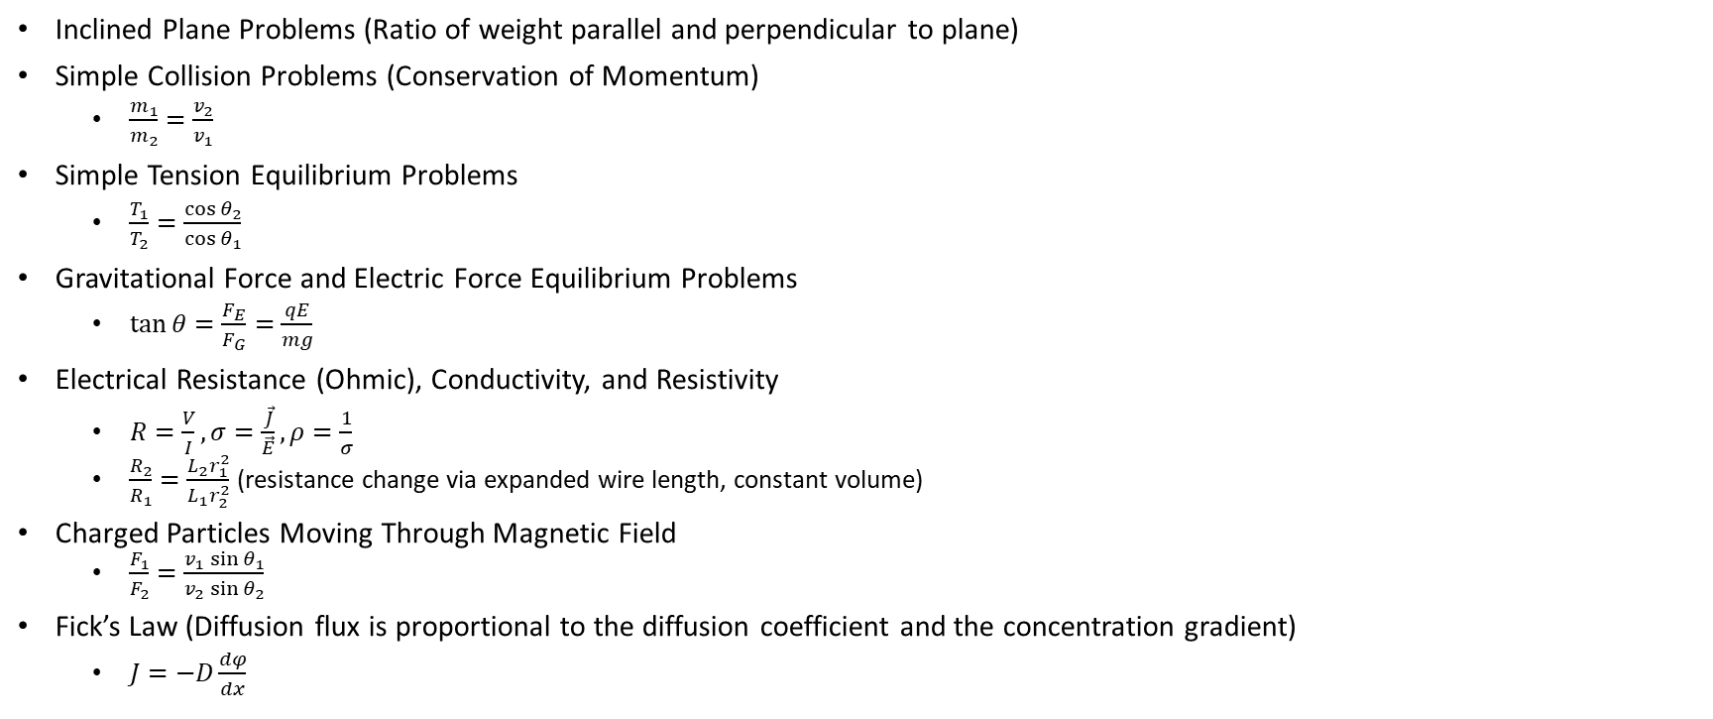
Examples of Ratios and Proportions
Inclined Plane Problems (Ratio of weight parallel and perpendicular to plane)
Simple Collision Problems (Conservation of Momentum)
$\frac{m_{1}}{m_{2}}=\frac{v_{2}}{v_{1}}$
Simple Tension Equilibrium Problems
$\frac{T_{1}}{T_{2}}=\frac{\cos{θ_{2}}}{\cos{θ_{1}}}$
Gravitational Force and Electric Force Equilibrium Problems
$\tan{θ=\frac{F_{E}}{F_{G}}=\frac{qE}{mg}}$
Electrical Resistance (Ohmic), Conductivity, and Resistivity
$R=\frac{V}{I}, σ=\frac{\vec{J}}{\vec{E}}, ρ=\frac{1}{σ}$
$\frac{R_{2}}{R_{1}}=\frac{L_{2}r_{1}^{2}}{L_{1}r_{2}^{2}}$ (resistance change via expanded wire length, constant volume)
Charged Particles Moving Through Magnetic Field
$\frac{F_{1}}{F_{2}}=\frac{v_{1}\sin{θ_{1}}}{v_{2}\sin{θ_{2}}}$
Fick’s Law (Diffusion flux is proportional to the diffusion coefficient and the concentration gradient)
$J=−D\frac{dφ}{dx}$

Slide 14

Ratios in Physics (Constants & Coefficients)
Speed of Light
$c=\frac{E}{B}$
Friction Problems (Coefficient of Friction)
$μ_{k}=\tan\left(θ\right)=\frac{v^{2}}{rg}$
Collision/Fluid Flow Problems (Coefficient of Restitution/)
$e=$
Optics (Index of Refraction)
$n_{m}=\frac{c}{v_{m}}=\frac{λ_{o}}{λ_{m}}={\frac{\sin{θ_{o}}}{\sin{θ_{m}}}n}_{o}$
Springs (Stiffness Coefficient)
$k=$
Dampeners (Dampening Coefficient)
$ζ=$
Dielectric Constant
$κ=\frac{E_{o}}{E}$

Slide 15
Ratios in Physics
Electric Field Strength Proportional to Charge or Field Line Density
System Stability
Convergence and Divergence

Slide 16
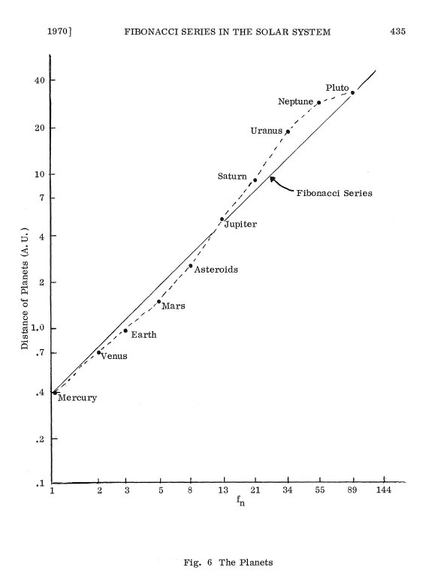
Ratios Beyond Physics
Statistics:
% Error and % Difference
Mathematics:
Golden Ratio
Fibonacci Sequence
Distance of Planets
https://www.fq.math.ca/Scanned/8-4/read-a.pdf

Slide 17
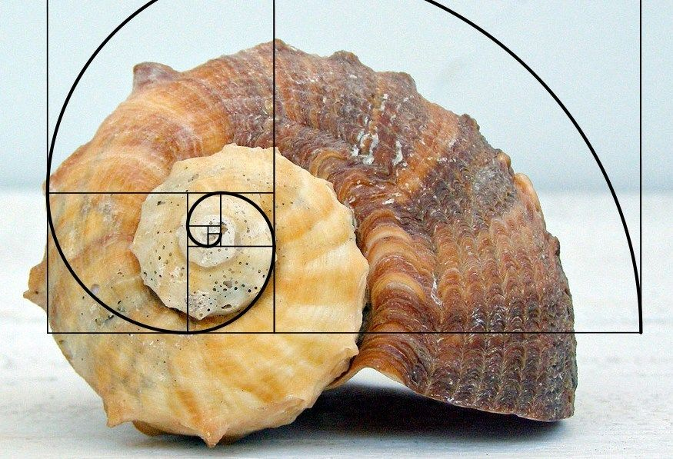
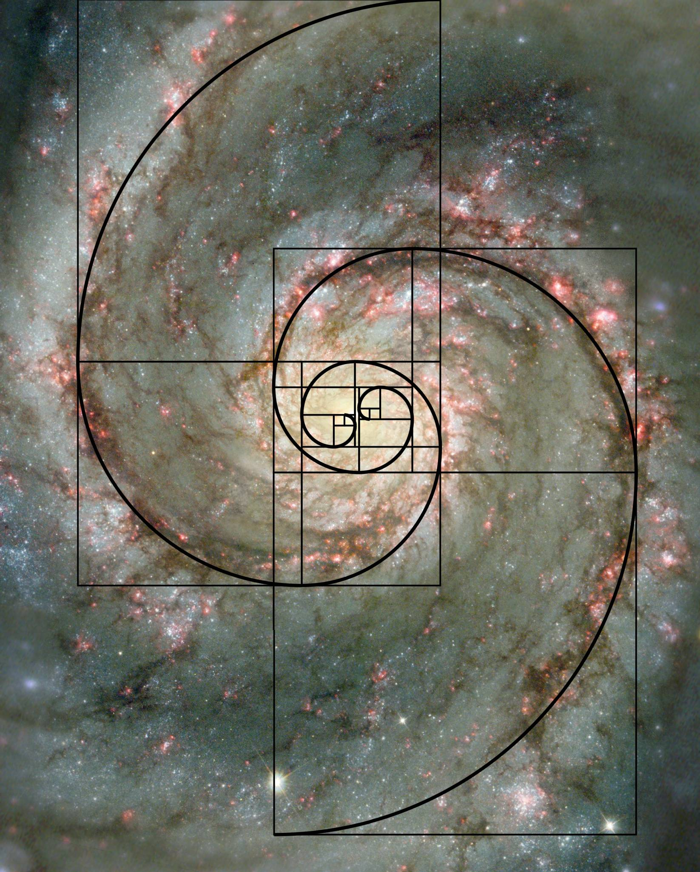

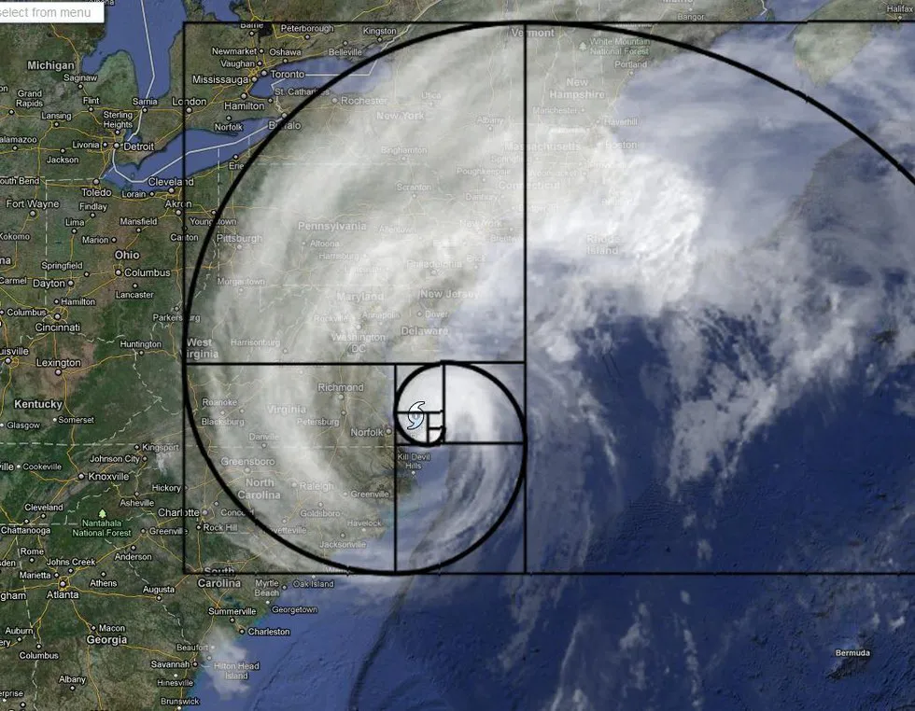

Slide 18
Ratios Beyond Physics
Biology:
Genetic Ratios (Mendel’s Law of Segregation)
Convergent Evolution
Surface Area to Volume Ratio
Population Growth
Photosynthesis and Light Intensity
Chemistry:
Gas Laws
Stoichiometry (ratios of reactants and products)
Reaction rate and concentration (rate proportional to concentration)
Molar mass ratios

Slide 19

Summary
Anything can be expressed as a ratio so long as the compared objects/parameters are dimensionally equivalent
Ratios are easy to create, proportionalities are difficult to establish

Slide 20
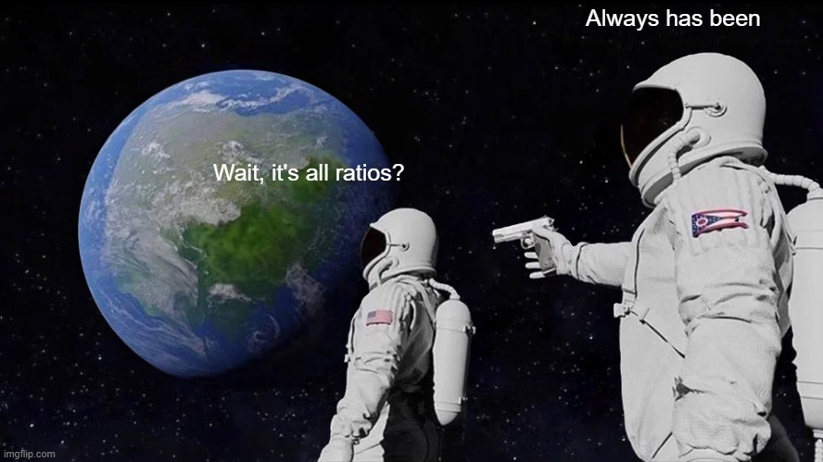
Questions?

